Slide 1
Public Presentation
John D. Muccigrosso

Slide 2
About Me

Slide 3
Closing or Closed
Marylhurst University
Hampshire College
College of St. Joseph (VT)
Green Mountain College
Mount Ida College
Wheeling Jesuit University

Slide 4

“But I promise you, folks can make a lot more, potentially, with skilled manufacturing or the trades than they might with an art history degree."
Barack Obama
January 30, 2014

Slide 5
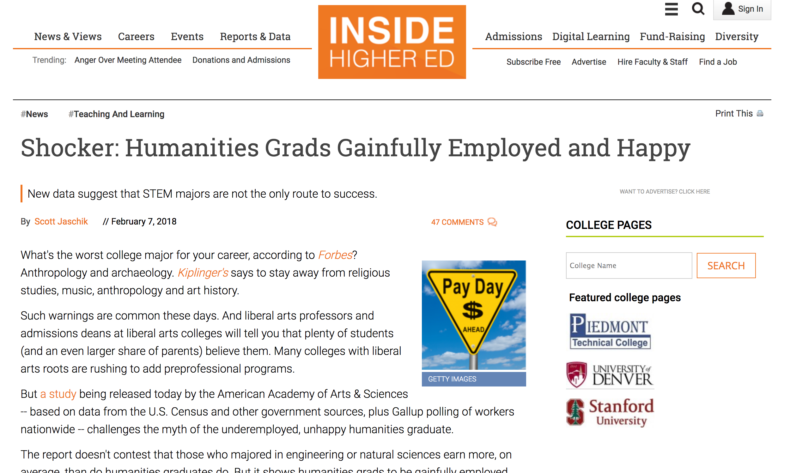
A Response

Slide 6
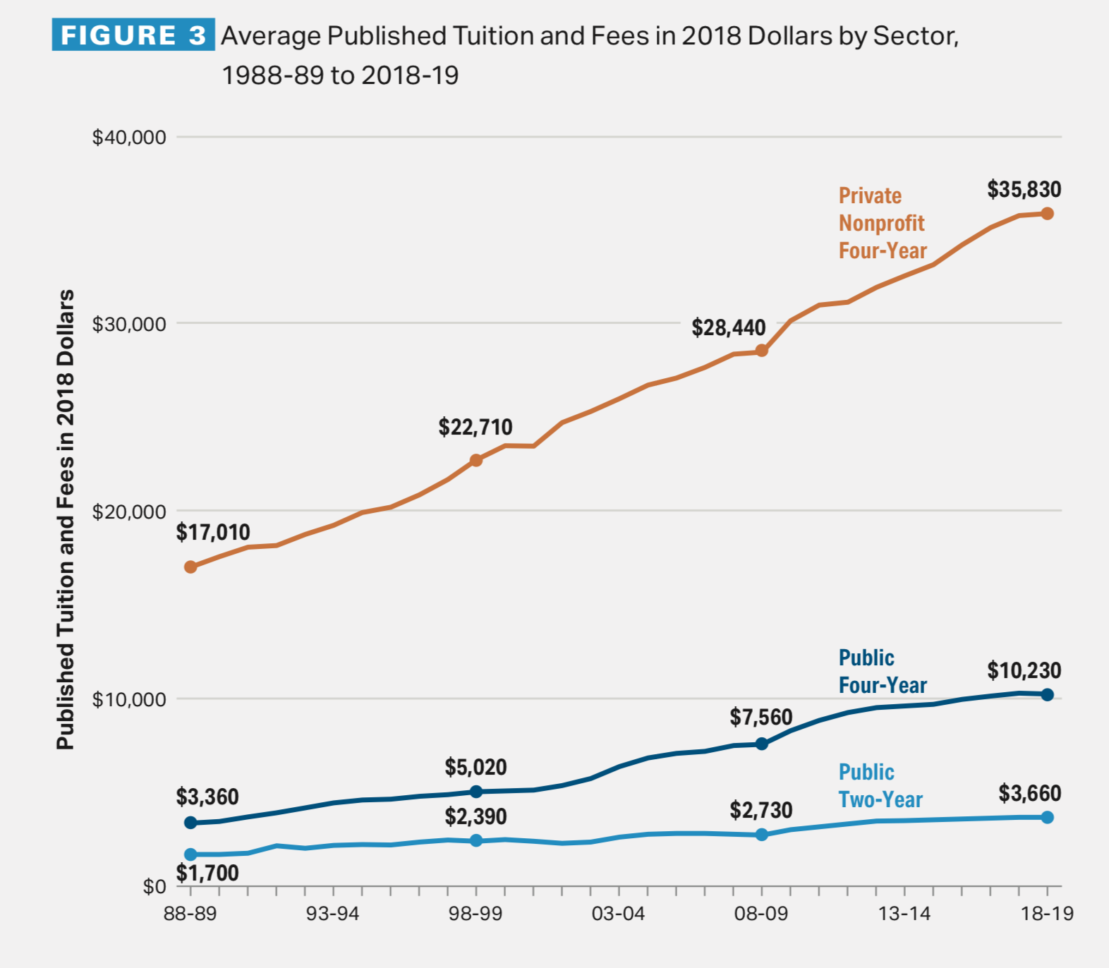
Tuition going up…

Slide 7
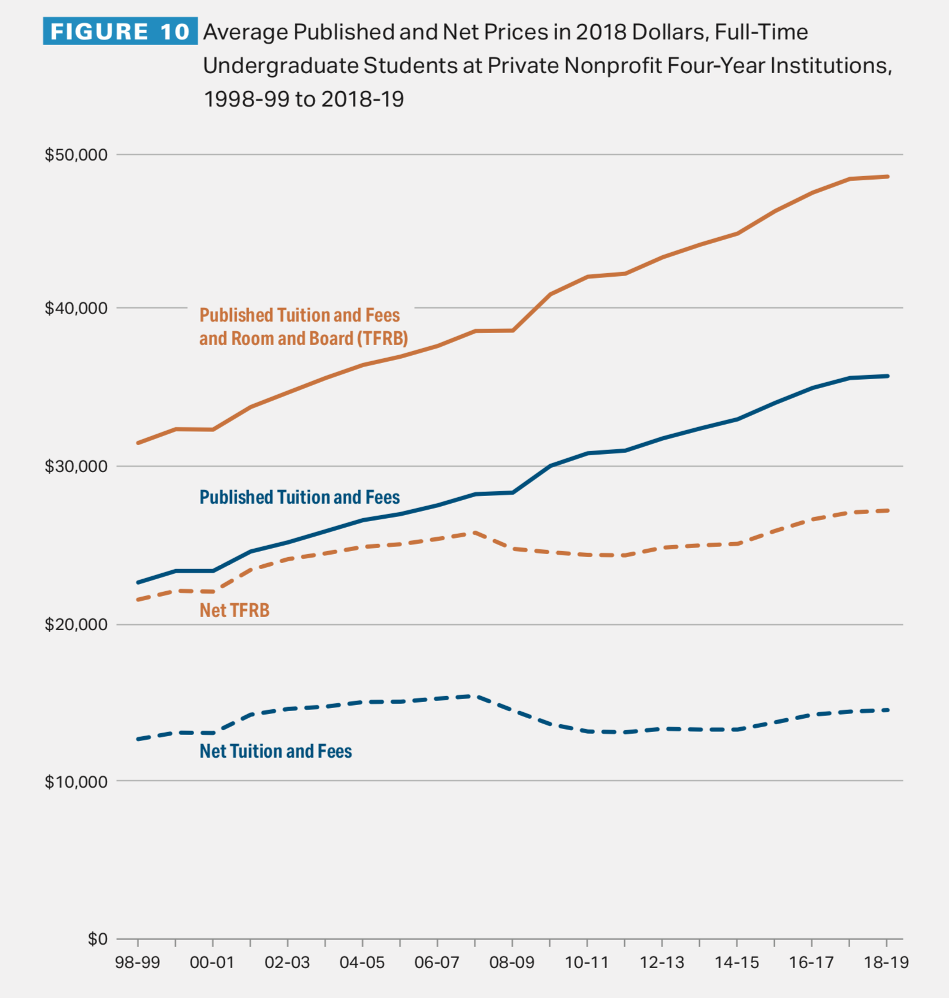
Discount going up…

Slide 8

Helicopter parents

Slide 9
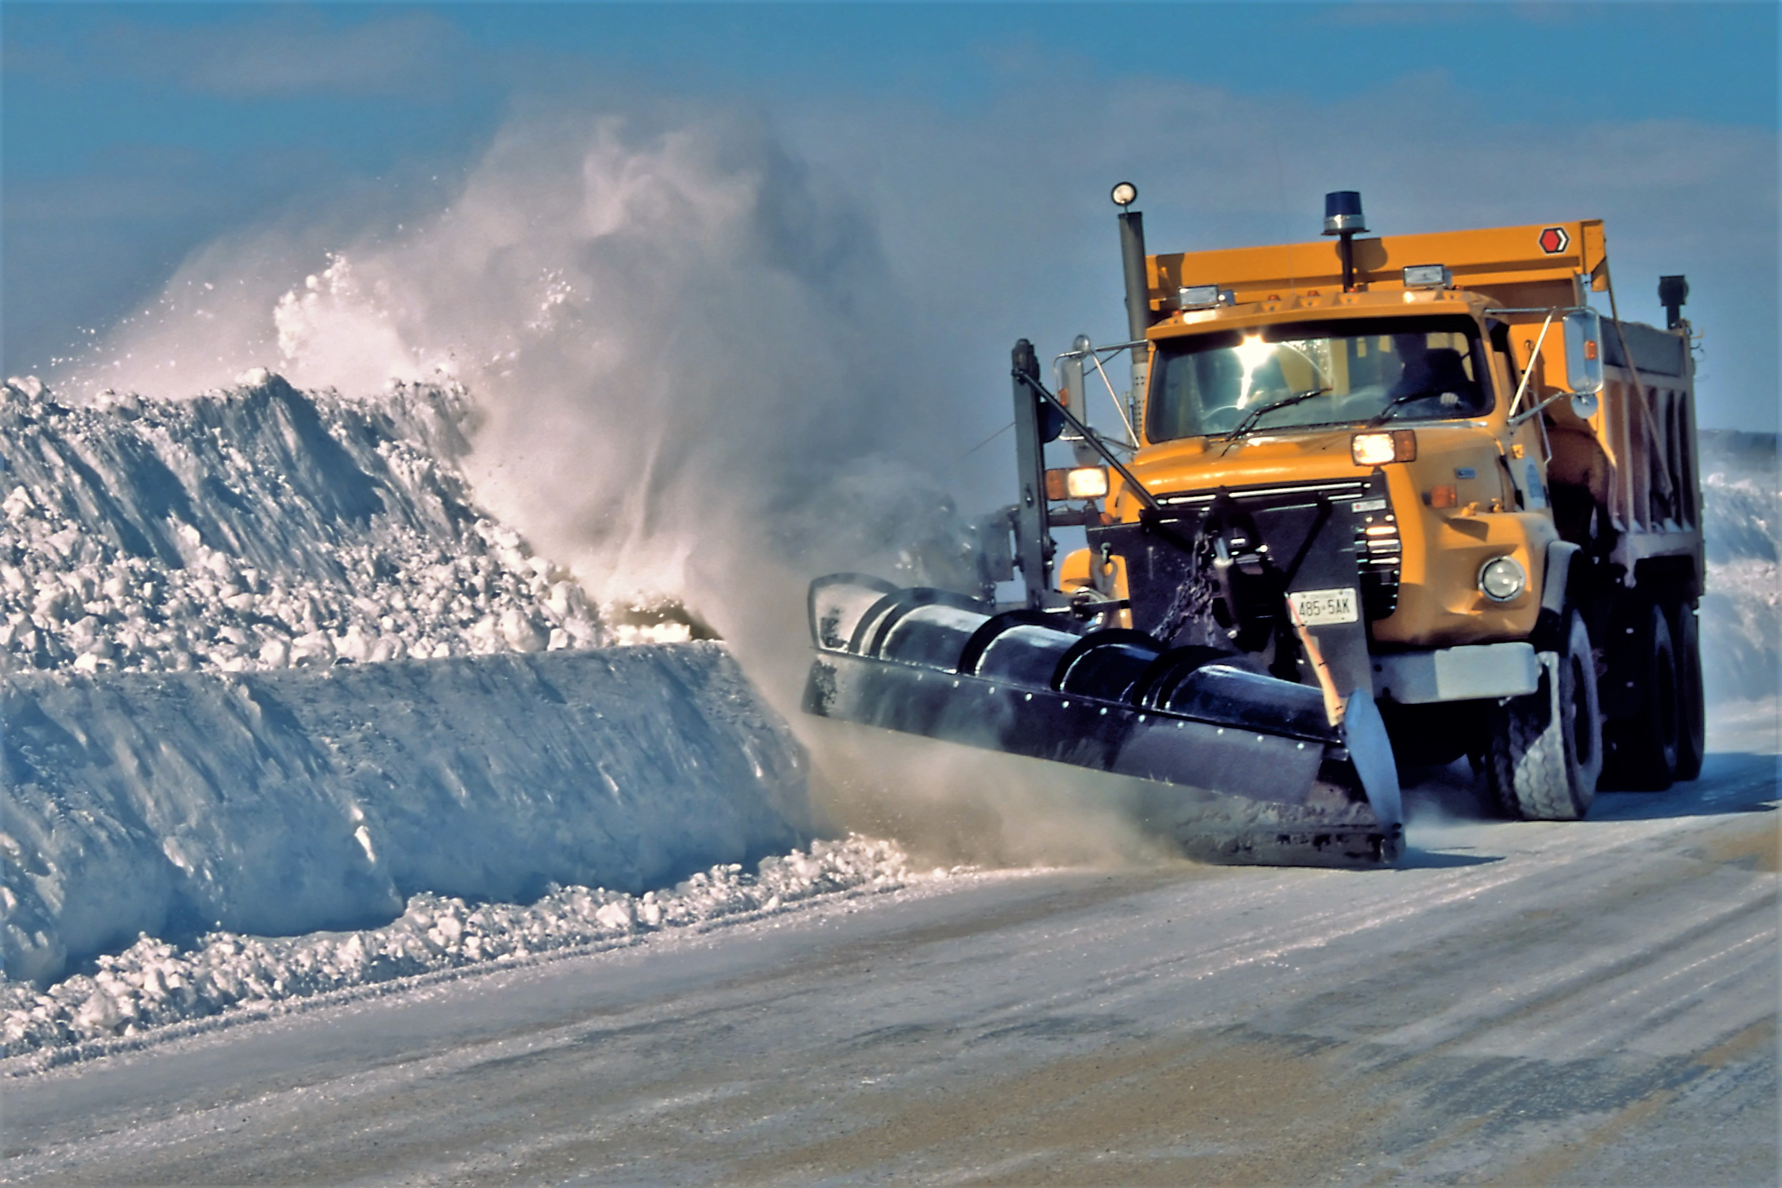
Snowplow parents

Slide 10
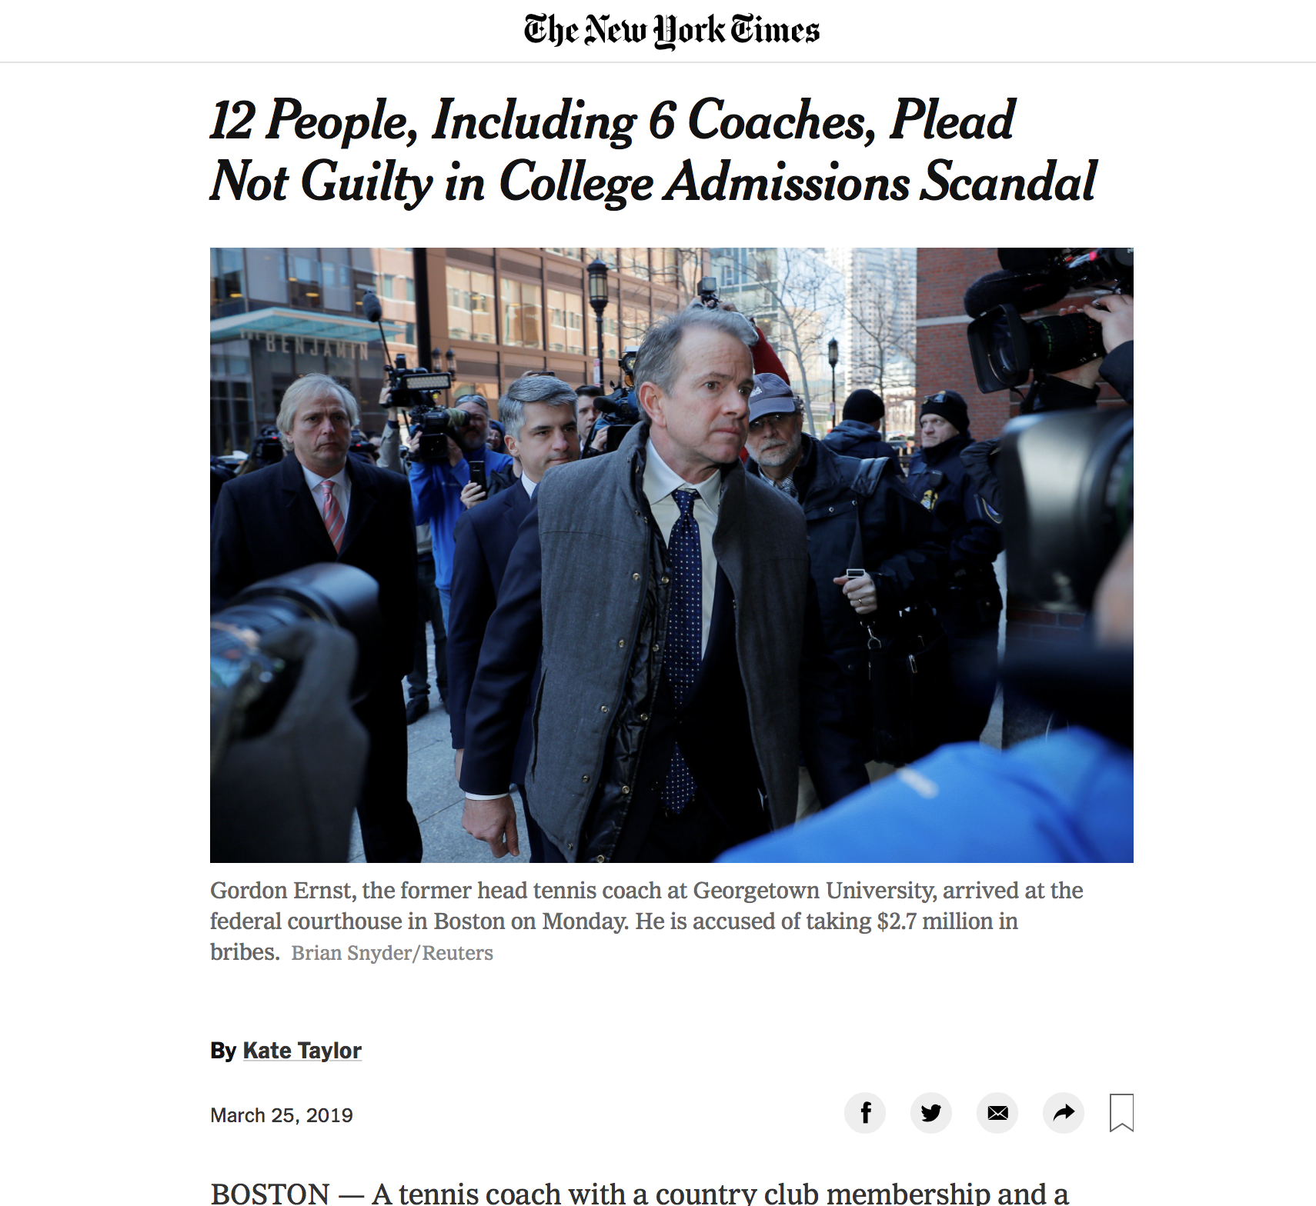

Slide 11
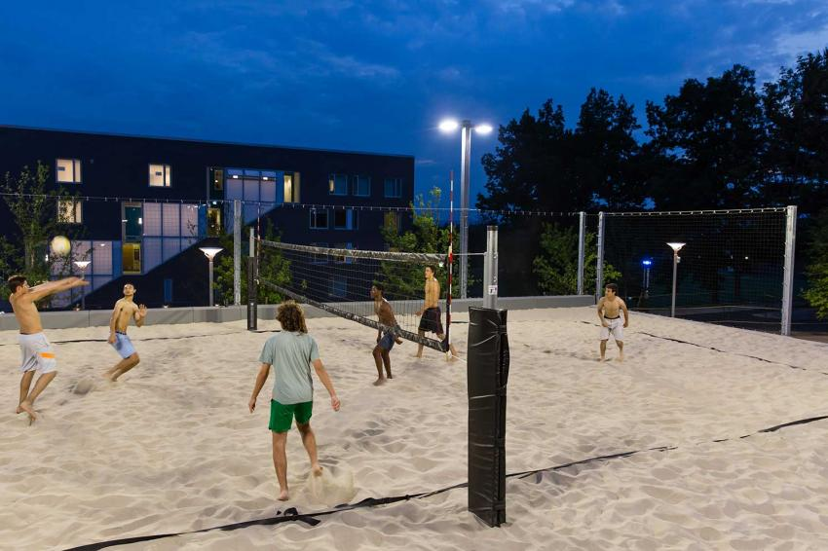

Slide 12
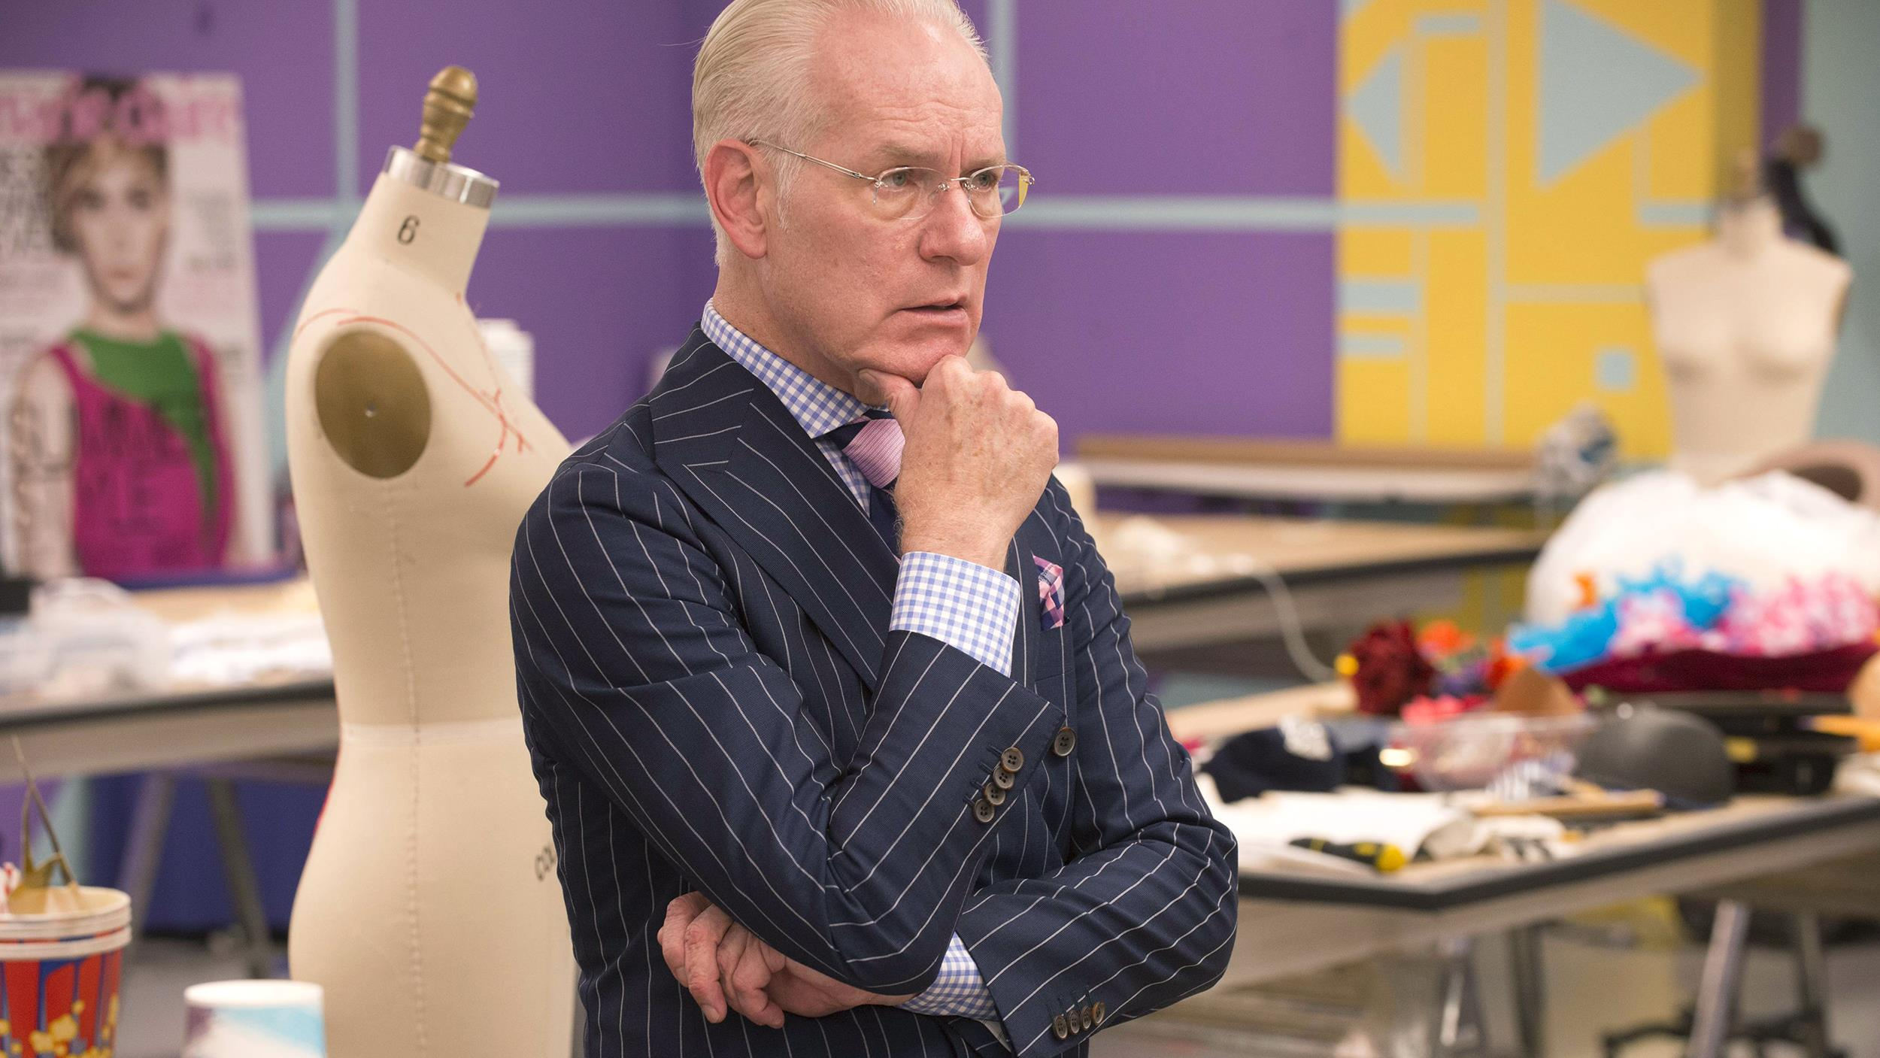
Make it work

Slide 13


Slide 14
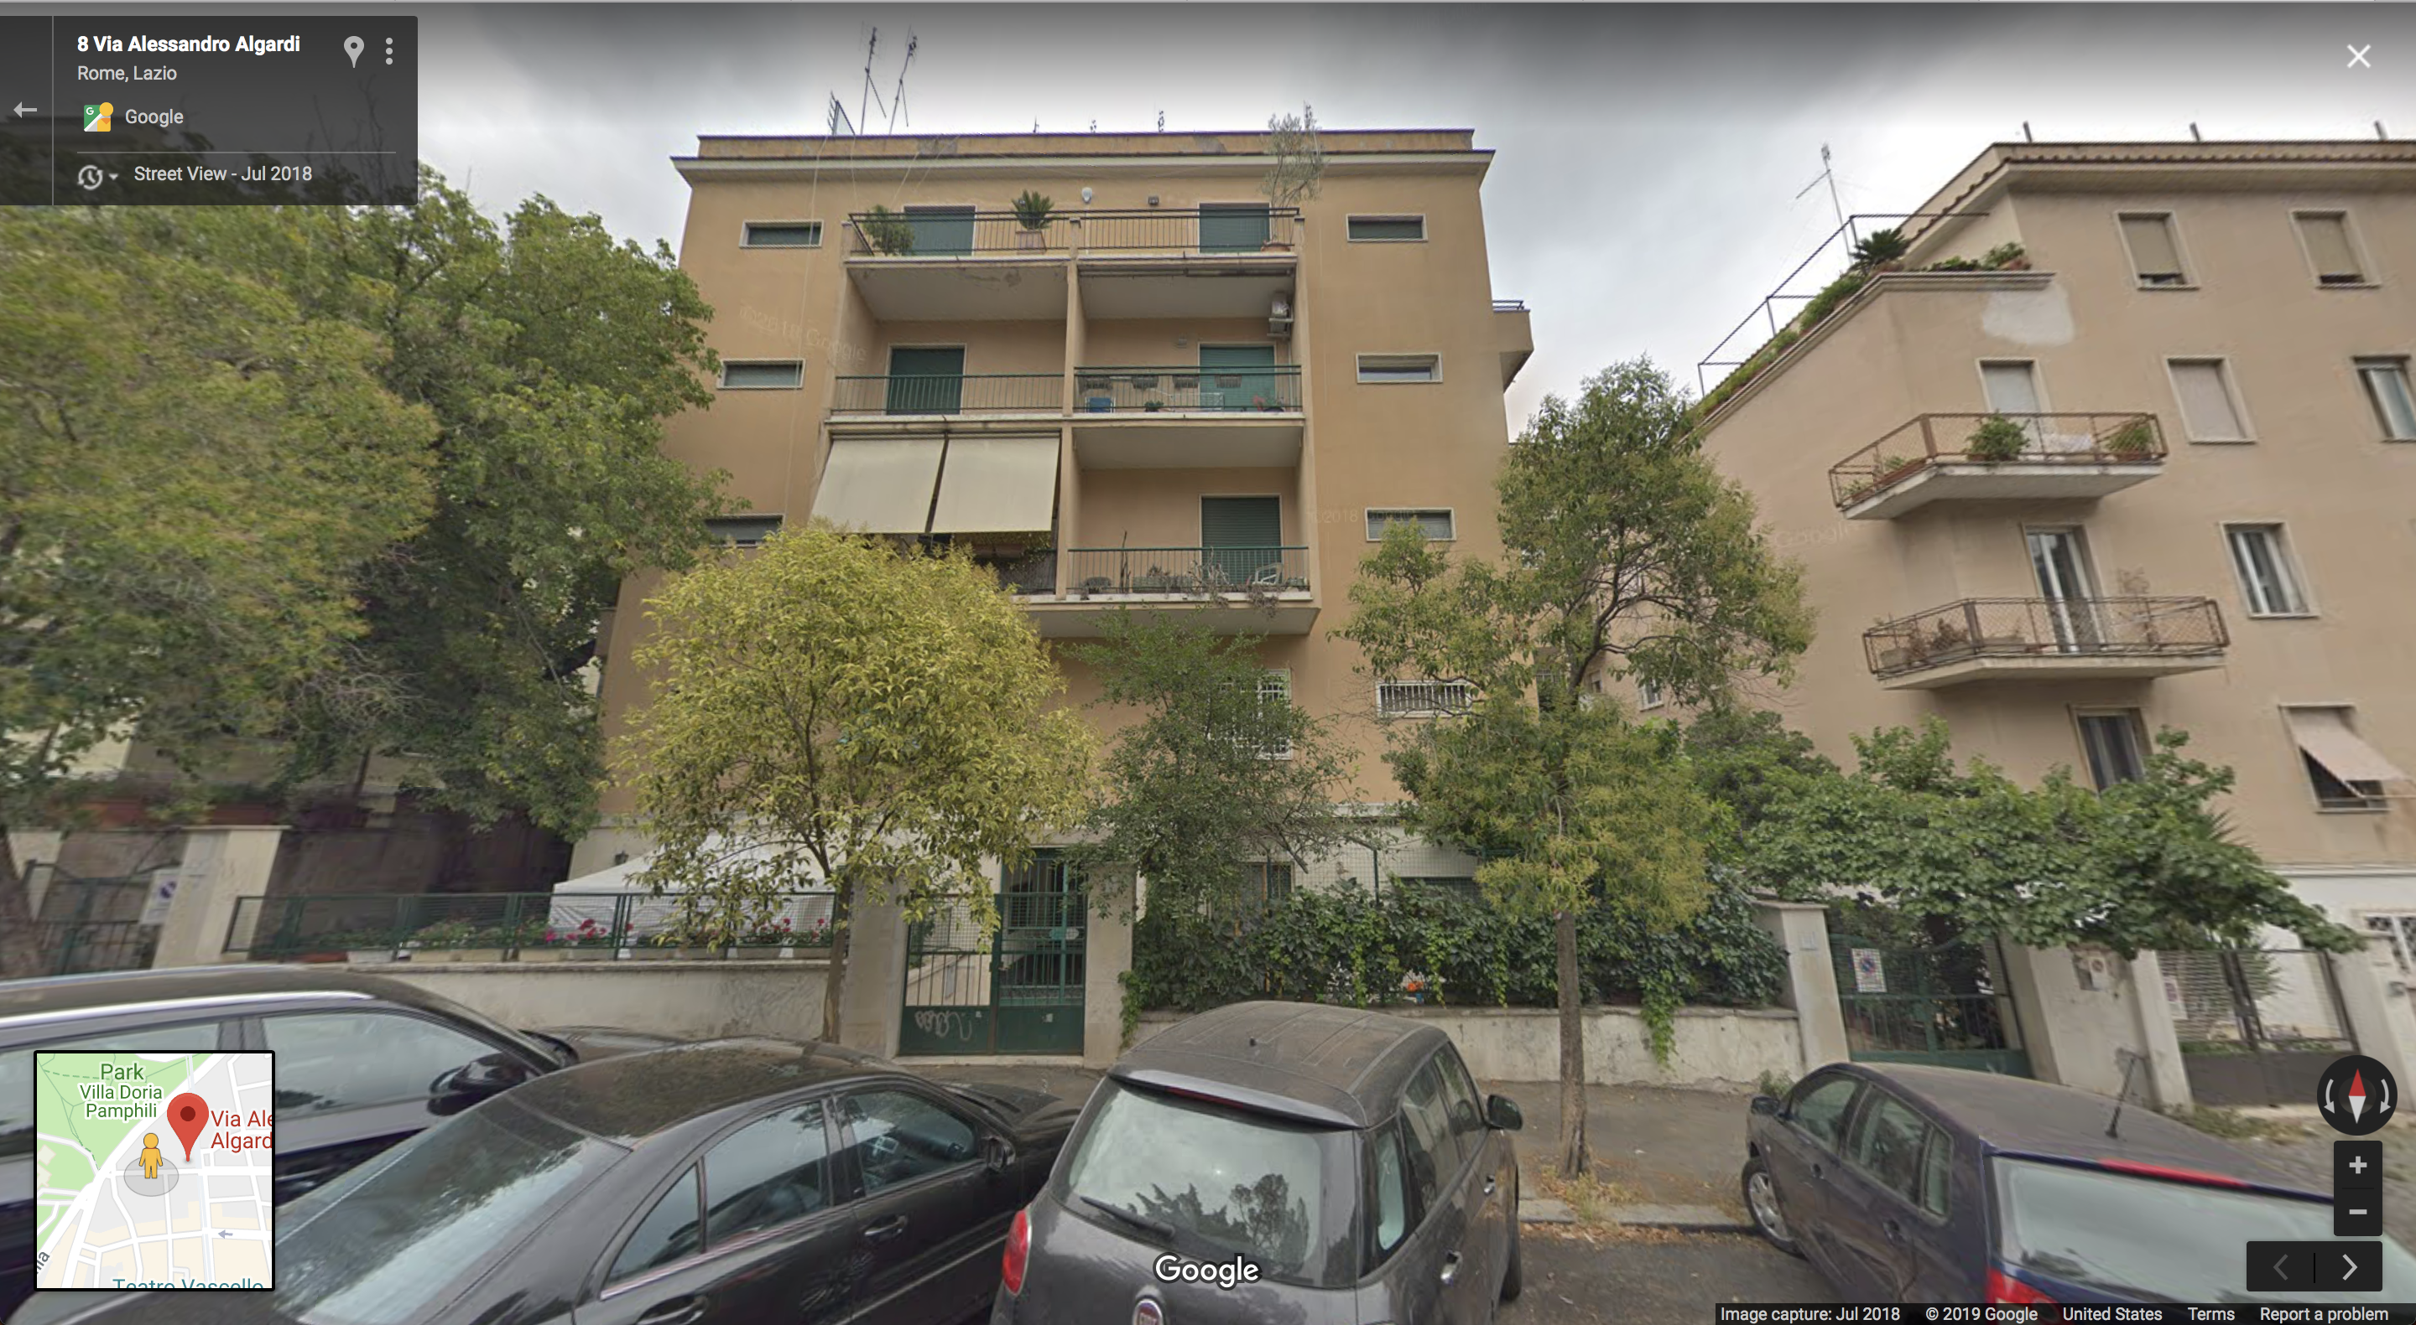
Rome-ward Bound

Slide 15
Image credits
Obama: Pete Souza, The Obama-Biden Transition Project, Creative Commons Attribution 3.0 License.
Helicopter: Raimond Spekking / CC BY-SA 4.0 (via Wikimedia Commons), CC BY-SA 4.0.
Snowplow: By Jeroen Kransen, Netherlands - Own work, CC BY-SA 2.5.
Tuition & discounting: Ma, Jennifer, Sandy Baum, Mattea Pender, and C. J. Libassi. 2018. “Trends in College Pricing 2018.” Trends in Higher Education Series. New York: The College Board.
Beach volleyball: Amherst College website.
Tim Gunn: NBC News.
Rome street: Google maps.

